Slide 1




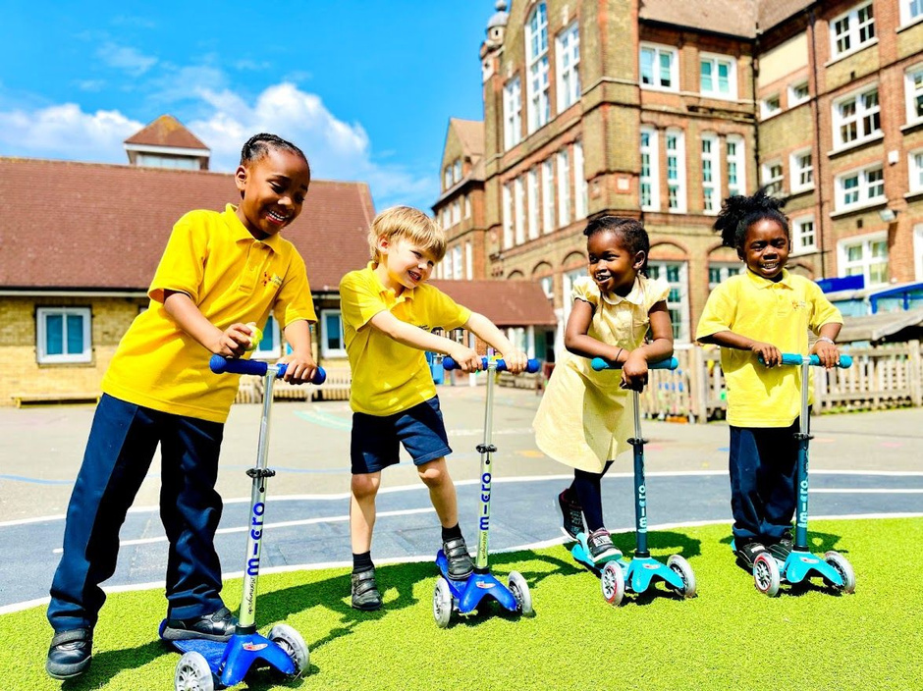

Morningside Primary School
and Children’s Centre
Application Pack Pastoral Manager

Slide 2


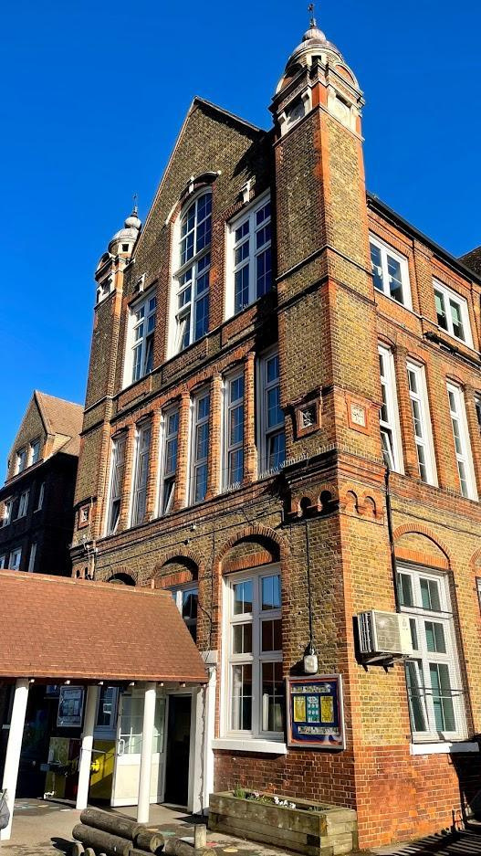

Contents Page
Welcome
3
3
About us
4
4
Working in partnership
5
5
School development plan
6
6
Job description:
Pastoral Manager
7-8
7
Personal Specification:
Pastoral Manager
9-10
10
11
How to apply
11
Contact information
12
12
Morningside Primary School is committed to safeguarding and promoting the welfare of children and expects all staff to share this commitment. We welcome applications from all sections of the community, regardless of sex, race, religion, disability, sexual orientation or age.

Slide 3





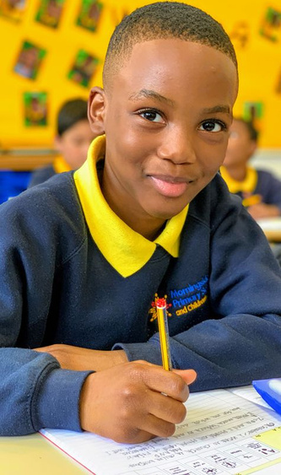
Welcome Letter
Dear applicant,
Thank you very much for your interest in the role of Pastoral Manager at Morningside Primary School. We hope you will ﬁnd this information a useful introduction to our school.
Morningside is an outstanding two-form entry primary school in the London borough of Hackney, located very close to Hackney Central in the heart of a diverse, vibrant and exciting community. Our children come from truly diverse backgrounds, many different languages are spoken. Our school has been through a period of considerable change over the last few years and our aim is to build on the hard work that enabled the school to make rapid improvements and to secure excellent learning opportunities for all of our families. We are seeking a Pastoral Manager who is highly motivated and talented to work alongside our dedicated staff to support children and their families.
Our new Pastoral Manager will join a very committed and hard-working staff body who all want to ensure that every child fulﬁls its potential, both now and in the future. If you share this vision and are committed to helping children overcome barriers to learning in every lesson, every day, we would like to hear from you. Please ﬁnd further guidance on Morningside, the type of colleague we are seeking to appoint and details on how to apply for the post within this pack. We welcome and encourage school visits. Please contact the school ofﬁce on 020 8985 5382 to arrange a suitable date and time.
Yours faithfully,
Rachel Smith and Jo Stonehouse
Co-Headteachers

Slide 4

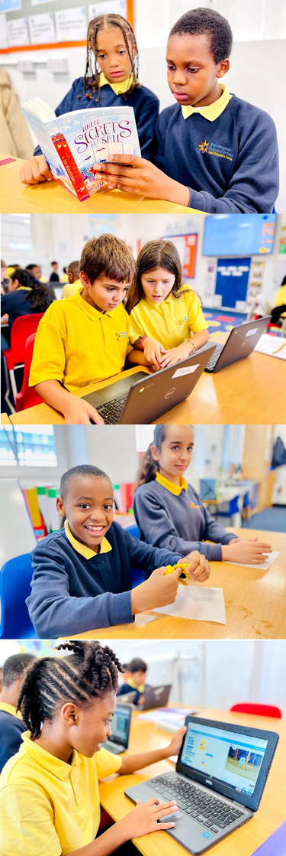






About Us
Welcome to Morningside Primary School and Children’s Centre. Morningside is a 2-11 two-form entry primary school with a Children’s Centre. Our community is culturally and ethnically diverse and we pride ourselves on being an inclusive school.
Our age range is from 3 to 11 years old and we have more than 400 on roll. There are two classes in each year group with 30 pupils in each class. We have two Nursery classes, one at the school and one in our Children’s Centre with sessions in the morning and afternoon, with some children attending on a full-time basis.
Close to 50% of our pupils are eligible for free school meals. 65% of pupils speak English as an additional language. Our on-site Children’s Centre supports members of our community and is where the two year old nursery is situated.
Our vision is for the school to be:
  A place where children can achieve their full potential in academic, creative, personal, physical, moral and spiritual development;
  A caring place where children and adults feel they make a contribution and are valued as individuals;
  A place where everyone is aware of their rights and responsibilities and where children learn respect for themselves and others;
  A partnership between children, parents, staff and the community as a whole.

Slide 5


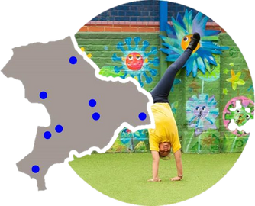




Working in Partnership
FEDERATION
PRIMARY ADVANTAGE FEDERATION
Morningside Primary School is a part of the Primary Advantage Federation.
We are a group of schools working together because we believe our schools can gain many beneﬁts from working collaboratively and can achieve more by working together. We have made a commitment to a shared responsibility to the wider education community, the provision of good quality education and the improvement of life chances for pupils in the community beyond that of our own schools. and Governors have added expertise in working alongside colleagues to improve provision and outcomes for pupils.
WHAT OUTCOMES DO WE WANT?
  Every teacher is a good teacher; every school is a good school
  Teachers who use the most effective teaching methods to motivate learners and raise aspirations. As a result all pupils will make good or better progress
  Quality learning environments where pupils feel safe and secure, known and valued and motivated to learn. Robust teaching and application of ICT skills ensure our pupils are properly equipped for the next stage of learning
  Curriculum provision which inspires and motivates pupils and broadens their horizons.
  We work with precision and move incrementally towards achieving outstanding grades in the majority of aspects of each school’s work
  Through pupil partnership work, we continue to break down locally perceived boundaries and help pupils to work harmoniously with pupils from other areas of Hackney
  We seek to maximise the efﬁciency and effectiveness of each school by capitalising on centralised services and sharing systems
WHAT IS OUR APPROACH?
  We work in partnership, pooling our expertise and resources in order to achieve collectively what we may not be able to achieve individually
  We believe passionately in improving the life chances for our pupils
  We do not tolerate low expectations
  We match tried and tested strategies that we know work to the needs of the schools and use our experience of supporting schools in successfully implementing them
  We promote a collaborative approach whilst developing the capacity of each school to serve its own community and retain its distinct identity
  We recognise the importance of individuality, spontaneity and creativity in developing innovation
SCHOOLS ACHIEVING
MORE TOGETHER...
Find out more about Primary Advantage Federation by visiting www.primaryadvantage.co.uk

Slide 6

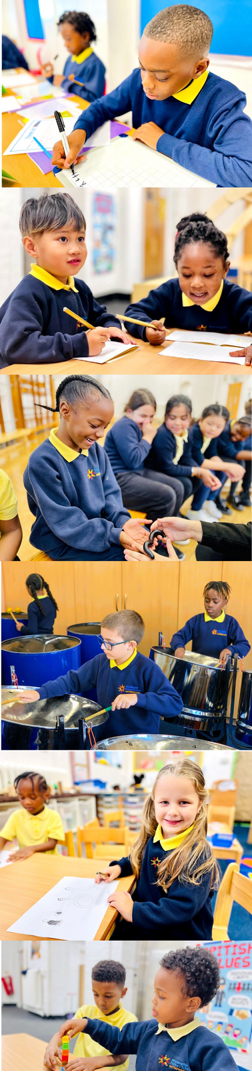




School Development Plan
Our key priorities are as follows:
Achievement for Pupils
To raise the profile of reading for pleasure
To further develop our use of oracy to support rich discussion
To continue to embed number fluency to support childrens’ calculation and problem solving
Behaviour and Safety of Pupils
To further embed our culture of excellent behaviour
To embed the principles of nurture and healthy relationships in our pastoral offer
To maintain our OPaL platinum status and strengthen the role of play across the school
To monitor attendance to ensure it is in the top 30%
nationally with no groups below target
Leadership and Management
To further develop our curriculum offer to focus on
the creative arts
To embed further creative enrichment experiences for pupils
To increase parental and community engagement so
that it impacts positively on pupils

Slide 7


Job Description
Pastoral Manager
Job Title: Pastoral Manager
Salary: SO1 (pro rata term time only)
Start Date: As soon as possible
JOB PURPOSE:
Reference: Mside/PM 2.25
MAIN DUTIES AND RESPONSIBILITIES:
  To help pupils to overcome barriers to learning both inside and outside of the school, in order to enable them to reach their full potential.
  To build positive relationships with families, acting as a key liaison to support engagement in their child’s education, signposting support services, and working collaboratively to enhance pupil well-being and achievement.
  To act as Deputy Designated Safeguarding Lead (DDSL), supporting the Designated Safeguarding Lead (DSL) in ensuring the highest standards of safeguarding practice, responding to concerns, and working with external agencies to protect children at risk.
  To act as the school’s Attendance Officer, monitoring attendance and punctuality, identifying patterns of concern, and working with pupils, families, and external agencies to improve attendance and reduce persistent absence.
  To provide strategic leadership for the pastoral team, fostering a culture of care, respect, and high expectations, and ensuring that pastoral support aligns with the school’s vision and values.
  To act as the Senior Lunchtime Supervisor and provide effective co-ordination and management of school lunchtimes.
  To provide effective co-ordination and management of the school’s extended day.
  To monitor attendance and punctuality throughout the school and to plan appropriate interventions with pupils and families.
  To liaise with the education attendance service, children social care and other external agencies.
  Support the Designated Safeguarding Lead (DSL) in ensuring that safeguarding policies and procedures are effectively implemented across the school. Act as a key point of contact for safeguarding concerns, providing advice and guidance to staff and responding to disclosures in line with statutory requirements and school policies.
  Assist in the identification, assessment, and referral of children at risk of harm to appropriate external agencies, including social care, CAMHS, and early help services. Follow up on referrals to ensure timely intervention and appropriate support.
  Maintain accurate, confidential, and up-to-date records of safeguarding concerns and actions taken using the school’s safeguarding recording system. Ensure that records are appropriately monitored and reviewed, contributing to case reviews and strategy meetings as required.
  To participate in the assessment of pupils being admitted or returning to school, and to identify those who need extra help to overcome barriers to learning both inside and outside of the school.

Slide 8
Job Description
Pastoral Manager
Job Title: Pastoral Manager
Salary: SO1 (pro rata term time only)
Start Date: As soon as possible
Reference: Mside/PM 2.25
MAIN DUTIES AND RESPONSIBILITIES Continued:
  To identify pupils who would beneﬁt most from additional support, and in consultation with others to formulate and implement an action plan for each pupil needing support.
  To develop a mentoring relationship with pupils needing support, with the aim of achieving goals identiﬁed in pupil action plans.
  To maintain regular contact with parents/carers of pupil identiﬁed, to keep them informed of the child’s needs and progress, and to promote positive family support and involvement.
  To promote the effective transfer of pupil information both within the school and between institutions, and to ensure the effective management of arrangements for casual leavers.
  To be responsible to the Co-Headteachers and Senior leadership team for the effective supervision and management of pupils in and about the premises and site of the school during the midday break. This includes the management of the midday staff.
  To be responsible to the Co-Headteachers and Senior leadership team for the effective supervision and management of pupils and activities in and about the school premises and site of the school during the extended day.
  To provide a varied menu of activities (study support, music tuition, dance, drama, arts and crafts, special interest clubs and ﬁrst aid courses, visits, learning a foreign language).
  To provide support and information, to families including parent workshops.
  To assist the Finance & Administration Manager in coordinating and supporting relevant funding bids To promote the school’s Healthy Schools agenda.
  To secure family support for targeted pupils where appropriate.
  To target efforts on those at risk of underachieving and who are not the responsibility of the SENCo
  To have full knowledge and understanding courses, opportunities and individuals that could be drawn upon to provide extra support for pupils.
  To assist pupils and families new to the country and the school in understanding the education system, school routines and how best they can support achievement.
  To provide information and advice to enable pupils to make choices about their own learning, behaviour and/or attendance.
  To manage the secondary transfer process and to work with parents/carers and pupils and pupils to ensure their understanding of the requirements of the process.
  To access the school database and provide reports for monitoring and evaluation purposes as required to feed into general school reports.
  To take the lead role, in liaison with the inclusion leader in the development and implementation of appropriate behaviour management strategies.
  To challenge and motivate pupils, promote and reinforce self-esteem.
  To be responsible for developing pastoral programmes for children to take place out of school hours when required.

Slide 9
Job Description
Pastoral Manager
Job Title: Pastoral Manager
Salary: SO1 (pro rata term time only)
Start Date: As soon as possible
Reference: Mside/PM 2.25
MAIN DUTIES AND RESPONSIBILITIES Continued:
GENERAL:
  To network with other Pastoral Support Managers within the borough to share ideas and best practice.
  To carry out and complete the administrative duties alongside ofﬁce staff as are relevant to the role.
  To provide reports for governors and attend meetings when necessary.
  This is not an exhaustive list of duties and responsibilities, and the postholder may be required to undertake other duties which fall within the grade of the job, in discussion with the manager.
  This job description will be reviewed regularly in the light of changing service requirements and any such changes will be discussed with the postholder.
  The postholder is expected to comply with and guidelines, including those relating to Equal Opportunities, Health and Safety and the Conﬁdentiality of Information.
  The postholder may be required to work outside normal school hours on occasion, with due notice.
  Due to the nature of the post, candidates are not entitled to withhold information regarding convictions by virtue of the Rehabilitation of Offenders Act 1974 (Exemptions) Order 1975 as amended. Candidates who are selected for interview will be required to give details of any criminal convictions on their criminal self-record form and expected to disclose further information when requested.
  Because this post involves working in a child-centred environment, candidates are required to comply with the school's procedures in relation to Keeping Children Successful candidates will be required to undergo an enhanced DBS check prior to conﬁrmation of their appointment.

Slide 10
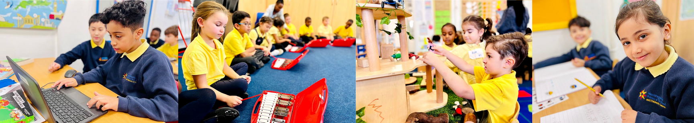



Person Specification
Pastoral Manager
Qualifications and Experience | NVQ level 3 or equivalent qualiﬁcation or experience in a relevant discipline | Essential
 | Current pædiatric first aid certiﬁcate/training | Desirable
 | Current safeguarding certificate/training | Desirable
 | Experience of as a DSL | Desirable
 | Experience of working effectively with vulnerable children & young people | Essential
 | Experience of working effectively with parents/carers | Essential
 | Experience of using any or all of Arbor MIS and My Concern (or similar) | Desirable
 | Experience of applying behaviour management systems and strategies | Desirable
 | Experience of overseeing student attendance, including the identification of concerns and the implementation of effective intervention strategies | Desirable
 | Experience of day-to-day welfare and safeguarding issues | Essential
 | Experience of working in a school environment | Desirable
Qualities, Skills and Knowledge | Has the best interests of children and young people as the guiding principles of personal practice | Essential
 | Understands the barriers faced by vulnerable young people within and outside of education settings | Essential
 | An up-to-date understanding of relevant legislation, policies and codes of practice, e.g. child protection, data protection and freedom of information. | Essential
Essential
Desirable
Essential
Desirable
Desirable
Essential
Essential
Essential
Essential
Essential
Essential
Essential
Essential
Essential
Essential

Slide 11
Person Specification
Pastoral Manager
Qualities, Skills and Knowledge | Possesses good interpersonal skills and is able to communicate effectively verbally and in writing | Essential
 | Able to adapt personal style of communication to reﬂect a situation and/or need. | Essential
 | Able to deal with difficult situations in a calm and professional manner. | Essential
 | Leads by example in standards of behaviour in the work environment. | Essential
 | Maintains a professional and friendly outlook and approach to work during busy times. | Essential
 | Has strong organisational and time-management skills, with the ability to prioritise and work under pressure | Essential
 | Can work on own initiative and as a member of a team, knowing when to offer and request support | Essential
 | Able to collaborate with colleagues and agencies to develop and implement support programmes. | Essential
 | Able to create an environment of trust by delivering on promises. | Essential
 | Able to make routine decisions based upon guidelines and procedures laid down within established frameworks. | Essential
 | Is IT literate, with a working knowledge of Google Suite applications | Essential
 | Able to communicate in an additional language. | Desirable
 | Is committed to own professional development | Essential

Slide 12










How to Apply
1 2 3 4 5
Job Description & Personal Speciﬁcation Please read the job description and person speciﬁcation carefully
Application Form Complete the Primary Advantage application form either electronically or print it off and hand write it
Supporting Statement Ensure your supporting statement relates to the competencies outlined in the person speciﬁcation
Employment History Candidates are advised that when completing the references section on the application form to please ensure that:
•Your first referee is your current, or most recent, employer
•You provide a referee who can conﬁrm your ability for the role
Send Application Form
Completed application forms must be received by Monday 3rd March 2025 (noon) and emailed to:
data@morningside.hackney.sch.uk
Candidates must ensure that if they are successful at interview, that they are able to provide evidence of their Right to Work and Remain in the UK. The school is not able to employ any person who cannot validate their Right to Work and Remain in the UK in the line with the Asylum, Immigration and Nationality Act 2000. Successful candidates will be required to apply for an enhanced Criminal Record Check via the DBS. We are committed to safeguarding and promoting the welfare of our children and expect all members of staff to share this commitment.
We look forward to receiving your application.

Slide 13




















Information
If there is any other information that you would like please get in touch. We will get back to you as soon as possible.
Contact Information
Morningside Primary School and Children’s Centre Chatham Place London E9 6LL
020 8985 5382
admin@morningside.hackney.sch.uk
Scan QR Code to launch school website
www.morningside.hackney.sch.uk
Executive Principal: Sian Davies
Co-Headteachers: Rachel Smith & Jo Stonehouse
Follow us on Instagram @morningside_hackney
Follow us on X
@ x.com/morningside_ps

